Slide 1
MASSACHUSETTS REGION 4AB EMERGENCY DISPENSING SITE WORKSHOP
June 6, 2019
Hotel Verve Crown Plaza

Slide 2
Agenda
Welcome, Introductions, and Background Information
Introduction to the Pandemic Influenza Planning Guidance
Module 1: Emerging Infectious Disease (EID) Surveillance
Module 2: Critical Staff Dispensing Eligibility and Notification
Module 3: Critical Staff Dispensing Staffing and Location
Module 4: EID Risk Communications
Lunch
Module 5: EID Vaccine Management
Module 6: EID Personal Protective Equipment
Module 7: EID Behavioral Health
Debrief and Wrap Up

Slide 3
Introductions by Jurisdiction
One person introduce all town or city representatives by role

Slide 4
Workshop Purpose & Goal
Collaborate to identify strategies to address emerging infectious diseases (EID) through existing local EDS plans
Strengthen capability to protect the health and safety of critical staff in public health emergencies

Slide 5
Workshop Objectives
Describe guidance relative to six planning considerations for EID and EDS:
Surveillance
Risk communication
Vaccine management
Personal protective equipment
Behavioral health
Critical staff dispensing
Identify strengths and gaps in jurisdictional EDS plans relative to these six planning considerations.
Collaborate with regional partners to identify promising practices that may be incorporated into jurisdictional EDS plans to these six planning considerations.
Contribute to the development of template plan content.

Slide 6
Guiding Principles for Workshops
Designed to develop a new plan, agreement, or procedure
Scenario-based discussion
Work within the scenario to achieve objectives
Large and small group activities
Emphasis on finding improvements
Low stress, no fault environment
Ask questions, challenge assumptions
No trick questions

Slide 7
Workshop Participants
Players
Facilitators
Notetakers
Observers
Notes:
·

Slide 8
Assumptions & Artificialities
The scenario is plausible
Local/regional focus, assume state-level response is proceeding
There are no other incidents occurring
Events occur as they are presented
No hidden agenda and no trick questions
All players are receiving the information at the same time
This exercise contains no fire drills or other functional exercise elements

Slide 9
Questions?

Slide 10
Introduction to the Pandemic Influenza Planning Guidance: Vaccine Allocation and Targeting Guidance

Slide 11
Why focus on EID and critical staff dispensing?
Historical focus on medication dispensing (i.e. anthrax, SNS)
Four influenza pandemics in the past century (2009 H1N1)
Monitoring viruses with pandemic potential (H5N1, H7N9)
Only 40% of PHEP programs have a plan to identify and vaccinate critical staff
Gaps identified during CDC Operational Readiness Review (ORR)

Slide 12
Elements of a Critical Staff Dispensing Plan
Responsible agency
Dispensing location
Source of dispensing staff
Source of MCM
Eligible agencies (number of staff/household members & EDS role)
Order in which agencies receive MCM
Communications plan and notification platforms
Schedule for notification drills and roster updates
Source: CDC PHEP Operational Readiness Review Guidance (2018)

Slide 13
Status of Critical Staff Dispensing Plans in 4AB
Early – based on CDC ORR evaluation criteria
Current 4AB plans document:
Timing (6 hours prior to opening the EDS)
Location (EDS or separate location)
Eligible agencies (found in only a few plans)
Workshop outcome: Customizable template critical staff dispensing procedures

Slide 14
Pandemic Influenza Vaccine Assumptions
Production and distribution within 12 weeks of pandemic declaration (HHS Pan Flu Plan 2017)
Source of vaccine is vaccine manufacturers
Early supply may not meet demand and will require targeted administration (based on epidemiology, severity, and potential for disruption of essential services)

Slide 15
Pandemic Influenza Vaccination Target
Vaccinate 80% of the population
2 doses separated by 21 days
Possible use of adjuvant (mixed at point of administration)
Completed within 12 weeks of vaccine availability
Critical staff dispensing completed within 4 weeks of vaccine availability

Slide 16
Seasonal Influenza Place of Vaccination
Ages 18-64
Ages 65+
Doctor’s office/HMO: 37.0%
Workplace: 21.1%
Store: 16.3%
Health Department: 3.5%
Doctor’s office/HMO: 45.6%
Store: 27.3%
Health Department: 3.3%
Source: 2016 Massachusetts Behavioral Risk Factors Surveillance System Survey

Slide 17
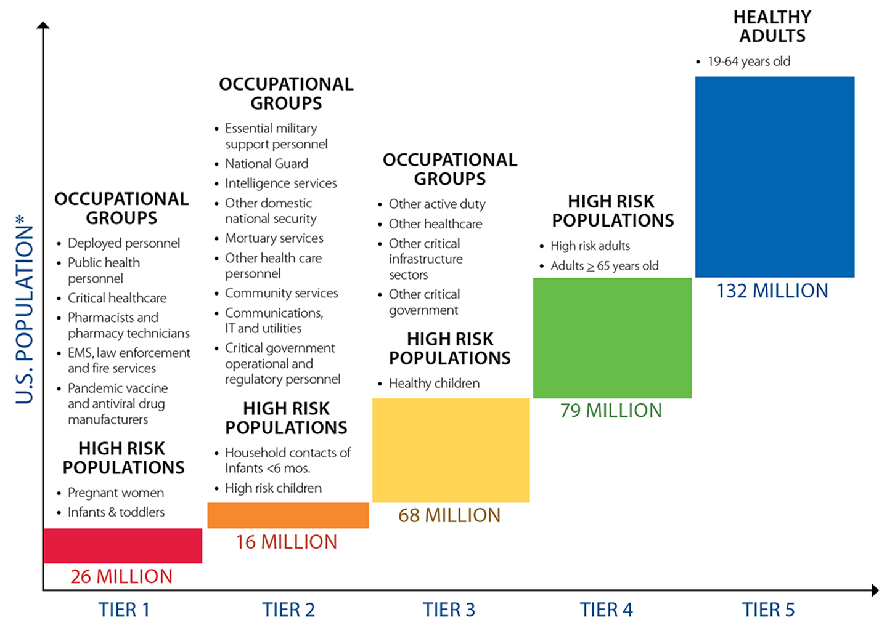
https://www.cdc.gov/flu/pandemic-resources/national-strategy/planning-guidance/guidance_508.html

Slide 18
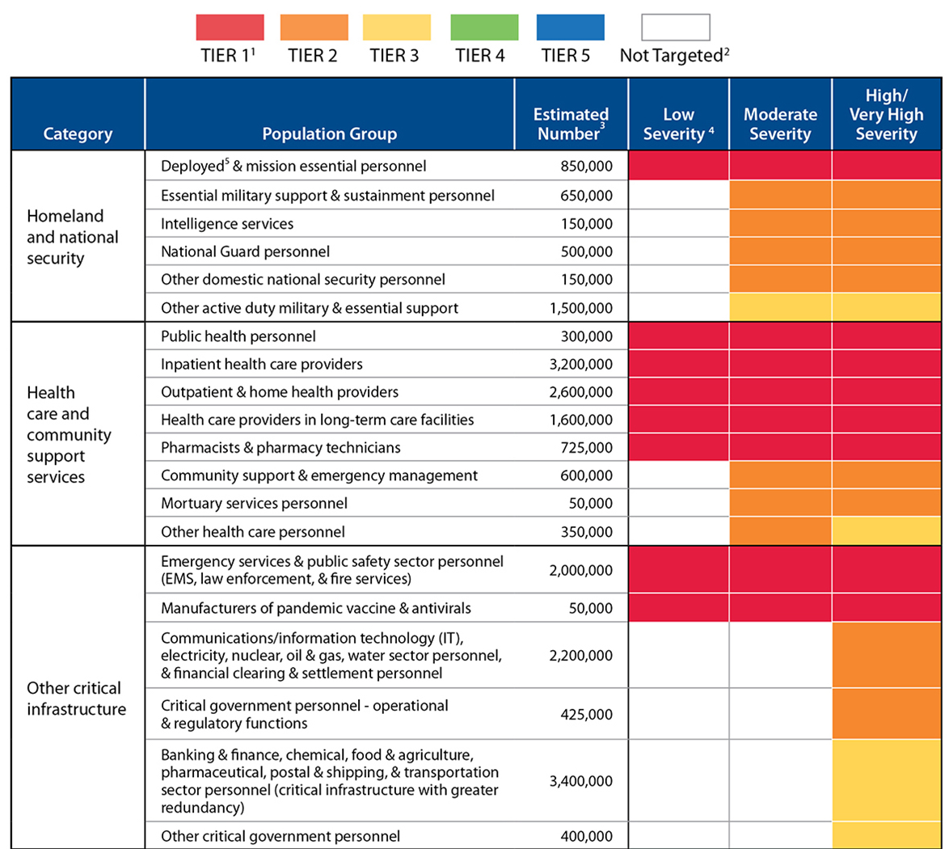
https://www.cdc.gov/flu/pandemic-resources/national-strategy/planning-guidance/guidance_508.html

Slide 19
Let’s Begin! (StartEx)

Slide 20
Module 1: EID Surveillance

Slide 21
Scenario: July
Highly pathogenic and novel influenza
Development of vaccine has begun, but vaccine is not yet ready
MDPH has advised towns to begin preparing for the activation of their EDS
Over last 6 weeks, small local outbreaks are first reported throughout the United States
https://www.popsci.com/scitech/article/2009-06/got-pandemic

Slide 22
Module 1 Guidance: Disease Surveillance
The collection, monitoring, analysis, and interpretation of health-related data
Used to define baseline levels of disease, detect unusual occurrences or increased frequency of disease, and recommend control and prevention measures

Slide 23
Module 1 Guidance: Surveillance Systems
Massachusetts Virtual Epidemiological Network (MAVEN)
Electronic Laboratory Reporting (ELR)
Weekly flu surveillance reports

Slide 24
Module 1 Guidance: Emergency Operations Center Activation
EDS plans should document procedures for EOC activation that include activation triggers and specify who is authorized to activate the EOC

Slide 25
Module 1 Discussion Questions
What mechanisms does your community use to monitor for unusual infectious disease activity? Which plans/section of your plan describe these mechanisms?
How would your community notify municipal and/or state authorities of unusual infectious disease activity?
What positions are listed as the primary and secondary local contacts for disease surveillance for MAVEN in your plan?
When notified of an incident that may require EDS activation, who does your plan say your local public health contacts should notify? Who is authorized to activate the EOC?
What triggers might lead to EDS activation according to your plan? Who is authorized to activate the EDS?

Slide 26
Module 2: Critical Staff Dispensing Eligibility and Notification

Slide 27
Scenario: Early September
First vaccine doses expected in October; limited supply for 3-6 months
By late September, outbreaks throughout New England
Virus with high transmissibility and clinical severity
CDC recommends targeting Tier 1 occupational groups for vaccination first
MDPH: Plan for vaccination of target population in early October
https://images.wagwalkingweb.com/media/articles/dog/vaccine-allergies/vaccine-allergies.jpg

Slide 28
Module 2 Guidance: Critical Staff
EDS plans should:
Define “critical staff”
Document eligibility
Estimate number of staff and immediate household members
Outline notification methods
DHS:
Critical staff are any position that is needed to ensure the continuity of operations of critical infrastructure and to maintain and protect the health and safety of the community

Slide 29
Module 2 Guidance: Vaccine Prioritization
CDC has developed guidance for targeting vaccines using population groups organized into tiers
Tier 1 is highest priority group
CDC target seeks to complete vaccination of critical staff within 4 weeks of vaccine availability

Slide 30
Module 2 Discussion Questions
Which type of agencies in your community have critical staff according to the Tier 1 criteria? Do these agencies also have an assigned or potential EDS role?
How might you determine the total number of staff for each critical staff agency? How might you estimate the number of immediate household members?
What notification methods are available in your community to notify critical staff of critical staff dispensing operations?

Slide 31
Module 3: Critical Staff Dispensing Staffing and Location

Slide 32
Scenario: September
Tier 1 vaccination expected to begin in early October
Critical groups reporting personnel shortages
Guidance states that vaccine will not be available to family members of Tier 1 occupational groups
https://news.yale.edu/2017/12/01/better-vaccine-targeting-study-identifies-key-mechanism

Slide 33
Module 3 Guidance: Critical Staff Dispensing Sites
EDS plans should document:
Location where critical staff and immediate household members will receive MCM
Source(s) of staffing for critical staff dispensing operations
Some current Region 4AB plans document two potential locations:
Activated EDS (prior to opening to the at-risk population)
Separate dispensing location

Slide 34
Module 3 Guidance: Critical Staff Dispensing Staffing
Critical staff dispensing will be conducted by organizations that will staff the EDS for the at-risk population (e.g., Public Health Nurses, Medical Reserve Corps (MRC) volunteers)
If at activated EDS, staffed by first shift
If at separate dispensing location, staffed by the BOH/Health Department or a mobile dispensing team that is deployed from the EDS, if activated

Slide 35
Module 3 Discussion Questions
What are the potential benefits of conducting critical staff dispensing at the EDS prior to opening to the at-risk population as opposed a separate location? What are the potential drawbacks? When would each strategy make sense?
What are the potential benefits of conducting critical staff dispensing at a location that is separate from the EDS? What are the potential drawbacks?
Which location type is currently documented in your community’s EDS plan?

Slide 36
Module 4: EID Risk Communications

Slide 37
Scenario: September
CDC report highlights case-fatality rates upwards of 15%
Public anxiety reaches a new high
Local media and public demand more information
https://emergency.cdc.gov/cerc/manual/index.asp

Slide 38
Module 4 Guidance: EDS Plan Requirements
EDS plans should document:
Primary and backup PIO staff
PIO position requirements and duties, roles and responsibilities, and qualifications, training, and skills

Slide 39
Module 4 Guidance: EDS PIO Role
Coordinates with partner agencies to activate public information notification systems
Develops and seeks approval of risk and safety messages
Disseminates risk and safety messages to partner agencies, the media, and the public in accessible formats
Coordinates with partner agencies to ensure information consistency
Provides regular updates to partner agencies, the media, and the public

Slide 40
Module 4 Guidance: Message Development
PIO gathers information from trusted sources and verifies its accuracy
PIO determines:
Limits on release of information
Communications goal
Target audience(s)
Key messages and supporting facts
Identifies key messages and supporting facts, including rationale for tiered dispensing, location of EDSs, and legally-required vaccine-specific information
Federal and state health officials develop clinical messages, while PIO develops messages related to local response actions and EDS operations

Slide 41
Module 4 Guidance: Dissemination Strategies
Prior to an emergency:
Document public information systems available through partner agencies
Develop a list of public information staff from partner agencies

Slide 42
Module 4 Guidance: Media Monitoring
EDS PIO should:
Monitor media
Address inaccuracies and rumors
Monitor trends in public information inquiries and adjust messaging and communication strategies

Slide 43
Module 4 Discussion Questions
What information would you expect to receive from the federal- or state-levels? How would you need to adapt this information prior to dissemination to your community? What other messages would you need to develop for your community?
How would you disseminate information to the public in a manner that is accessible to all? Which plans/section of plan describe this?
What resources are available for community members seeking additional information?
Who does the BOH/Health Department need to coordinate public information messages and dissemination with? How will this be done?
According to your plan, what are the requirements and duties, roles and responsibilities, and required qualifications/trainings for the PIO? Who are the primary and backup individuals to fill this role?

Slide 44
Module 5: EID Vaccine Management

Slide 45
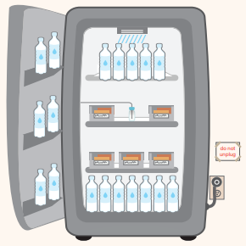
Scenario: Late September
Preparing to open EDS
First order of vaccine to be delivered Friday
Need to have protocols in place for:
Vaccine receipt
Vaccine storage
https://www.cdc.gov/vaccines/hcp/admin/storage/toolkit/storage-handling-toolkit.pdf

Slide 46
Module 5 Guidance: Receipt of Vaccine
SNS-supplied: EDS manager and a member of the security team greet delivery and sign a transfer of custody document
Manufacturer-supplied: Use existing protocols to order, accept, and track vaccine inventory
EDS Inventory Management Unit should verify all incoming resources (receipts) and confirm that delivered materiel matches the bill of lading

Slide 47
Module 5 Guidance: Storage of Vaccine
Protocols for:
Ensuring adequate freezer or refrigeration capabilities
Monitoring and maintaining the appropriate temperatures for vaccines at fixed locations
Trained cold chain management staff

Slide 48
Module 5 Guidance: Storage Capacity
Estimated Refrigerated Vaccine Storage Capacity by Number of Doses of Vaccine
Doses of Vaccine | Minimum Cubic Feet
1,000-2,000 | 40
900-1,000 | 36
801-900 | 21-23
701-800 | 17-19.5
400-700 | 16.7
100-399 | 4.9-6.7

Slide 49
Module 5 Guidance: Security and Cold Chain Maintenance During Transportation
Procedures for ensuring physical security of vaccine while it is being transported to the EDS
Police or private security
Processes and materials for maintaining cold chain during transportation

Slide 50
Module 5 Discussion Questions
What vaccine chain of custody procedures does your BOH/Health Department currently have in place? How might these procedures need to change given this scenario?
Are your BOH/Health Department chain of custody procedures referenced in your plan? Which plans/section of plan describe this?
What vaccine management procedures does your BOH/Health Department currently have in place?
What are the procedures for cold chain maintenance when vaccine is transported and administered offsite? What resources are needed to maintain cold chain during transport?
Are your BOH/Health Department vaccine management procedures referenced in your EDS Plan? If so, in which section?
How much secured vaccine storage capacity do you have at your BOH/Health Department? How many doses of vaccine do you have the capacity to store?
What provisions do you have to add additional storage capacity? What partners may be able to provide additional secured vaccine storage capacity?

Slide 51
Module 6: EID Personal Protective Equipment (PPE)

Slide 52
Module 6 Guidance: PPE and Workforce Protection
CDC recommends:
PPE recommendations for responders be developed in conjunction with partner agencies and risk-specific subject matter experts
Training/briefing personnel on how to use various types of PPE, including donning and doffing
Ensuring availability of PPE consistent with identified risks, associated job functions of public health response personnel, and federal and state guidance

Slide 53
Module 6 Guidance: Medical Waste
CDC recommends that plans include procedures for disposal of biomedical waste materials

Slide 54
Module 6 Discussion Questions
Does your community have a cache of PPE that may be used in an EDS? Who maintains the cache? Where else would PPE be obtained from?
Who determines recommended PPE during dispensing operations? Where would you look for guidance? Who would provide training and ensure access to appropriate PPE in an EDS?
Does your community’s EDS plan include Just-in-Time Training (JITT) on use of PPE?
How would the EDSs dispose of medical waste? Which plans/section of your plan describe these mechanisms?

Slide 55
Module 7: EID Behavioral Health

Slide 56
Scenario: Late October
Number of new cases have begun to decrease
CDC warns a second wave is expected
Increase of new patients exhibiting mental health issues
Expected that 20% - 40% of the surviving general population will experience PTSD, with 10% experiencing long term depression
Numbers higher among responders
https://www.istockphoto.com/photos/mental-health

Slide 57
Module 7 Guidance: EDS Behavioral Health Requirements
Provision of services that support an individual to maintain their emotional, psychological, and social well-being while working or receiving services at the EDS and after the MCM incident

Slide 58
Module 7 Guidance: EDS Behavioral Health Role
Support the behavioral health of EDS clients and staff
Station Behavioral Health Staff throughout EDS
Refer unaccompanied minors and clients exhibiting signs of stress to Behavioral Health
Give outgoing EDS staff time to debrief with Behavioral Health
Designate quiet area for Behavioral Health services

Slide 59
Module 7 Discussion Questions
What resources for behavioral health supports does your plan include? Do any plans include use of the MRC? Which plans/section of plan lists these resources?
Does your BOH/Health Department have a signed agreement with these resources to provide behavioral health support services at the EDS?
What additional organizations may be able to provide behavioral health support services at the EDS?

Slide 60
Debrief & Next Steps

Slide 61
Debrief & Next Steps
What information was new and useful from today’s discussion?
Of the 7 topics covered, which did you feel was the biggest gap for your jurisdiction?
For each gap, what additional information do you need to fill this gap?

Slide 62
FUNDING AND CONTINUING EDUCATION
Funding for this conference was made possible (in whole or in part) by the Centers for Disease Control and Prevention and/or the Assistant Secretary for Preparedness and Response. The views expressed in written conference materials or publications and by speakers and moderators do not necessarily reflect the official policies of the Department of Health and Human Services, nor does the mention of trade names, commercial practices, or organizations imply endorsement by the U.S. Government.
This activity has been approved for 5.5 Continuing Nursing Education contact hours through JSI Research & Training Institute, Inc. Activity #37538.0001 Nurses should only claim credit commensurate with the extent of their participation in the activity. JSI Research & Training Institute, Inc. is an approved provider of continuing nursing education by the Northeast Multistate Division, an accredited approver by the American Nurses Credentialing Center's Commission on Accreditation. No individuals in a position to control content for this activity has any relevant financial relationships to declare.

